Slide 1
Portable Unit for Ultraviolet Sanitation of Water
(PUVC)
Group 4
Joseph Wahlen PSE
Raymond Masciarella PSE
Damian LaRocque ECE
Sannidiyan Rajendran CPE

Slide 2
Motivation
COVID-19 Pandemic
The increasing public awareness of pathogens and how they spread
The heightened importance of cleanliness not only on the everyday person but also in their environment
3.4 million global deaths a year from waterborne disease caused by coliforms
Saw no solution for those in need of a moderately large supply of potable water supply, i.e 5-10 gallons but no access to developed water systems
Notes:
** Deaths and Infections taken from https://coronavirus.jhu.edu/map.html on 9/9/2020 **

Slide 3
Overall Project Goals
Develop a UVC light powered device to sanitize water of harmful coliform and pathogens
Develop a cost effective and efficient solution to allow for water sanitation
Be capable of running off of battery power and charging through solar
Be portable by a two person team and weigh less than 20 pounds empty
Create a system operable by any layman and that produces simple visual outputs

Slide 4
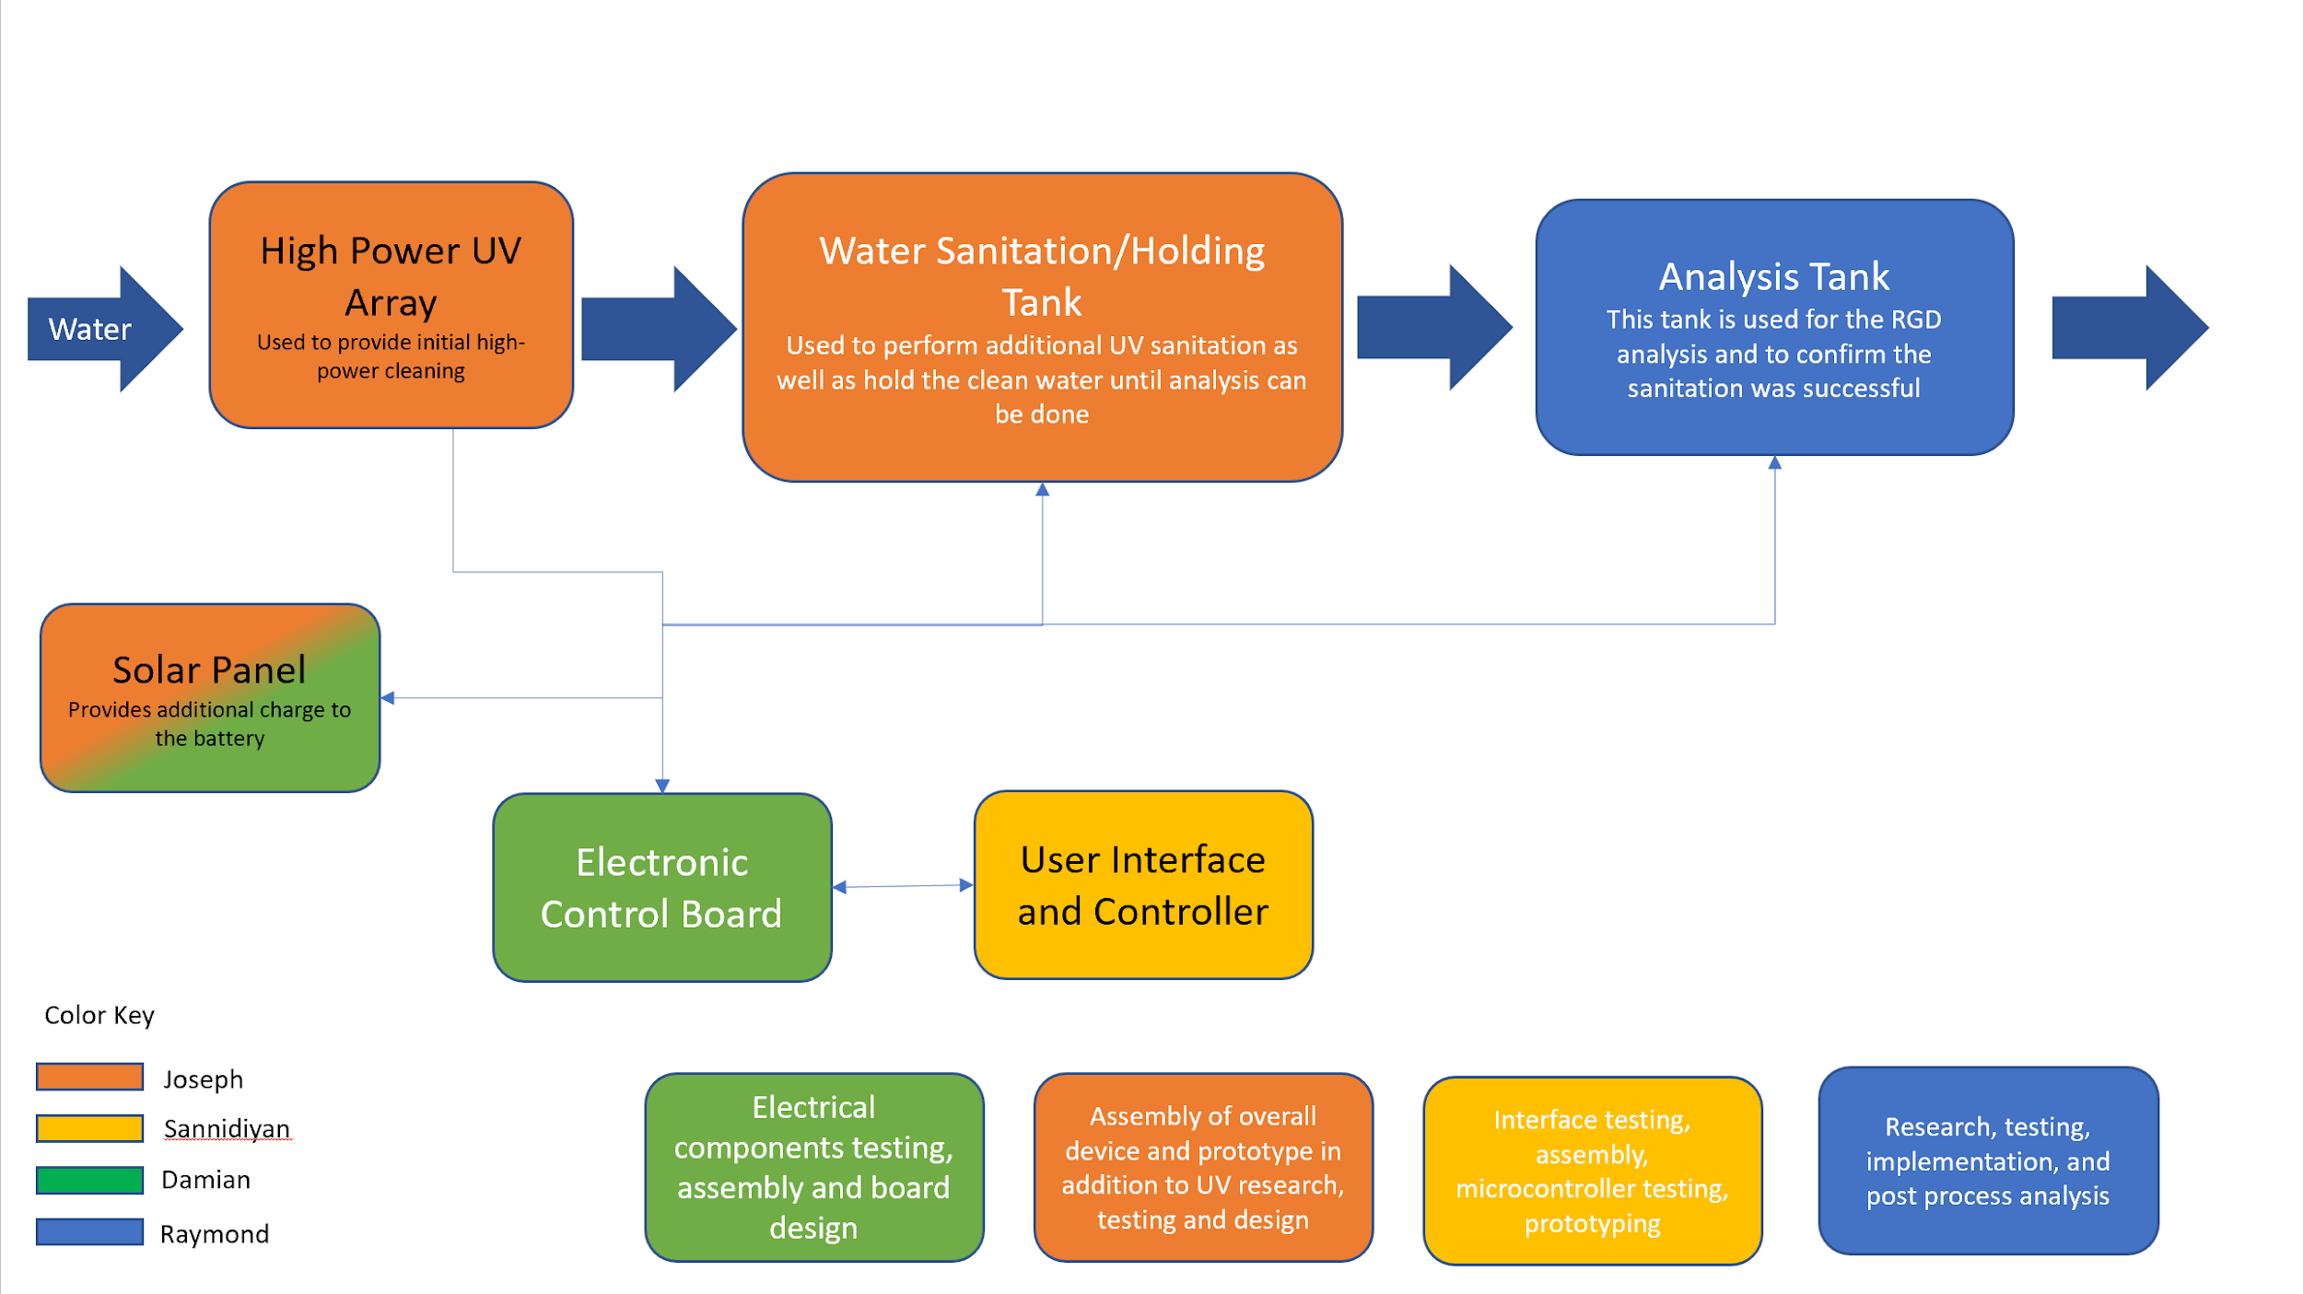
Overall Block Diagram of Project
Notes:
Here is the overall block diagram of the project. The water enters a high power UV Array for an initial rapid cleaning. It then goes to the holding tank for an additional UV cleaning, and finally it is pumped to the analysis tank for confirmation of a successful sanitation. This entire process is controlled by a user interface provided by the raspberry pi which is connected to the electronics of the system.

Slide 5
Specifications and Requirements
Achieved an effective power output from the LEDs greater than 50 mWs, additionally achieved an output near 5.4 Ws of UVC from the lamp
Provided a device equipped with three unique UVC emitters capable of processing the water
The PUVC when fully assembled fits inside a 3X3X3 foot space
Software and Sensor system runs off of a single MCU
User Interface is accessible and reactive via WiFi enabled device
The batteries are rechargeable by solar power
The device is capable of processing over 5 gallons per hour

Slide 6
Software system design

Slide 7
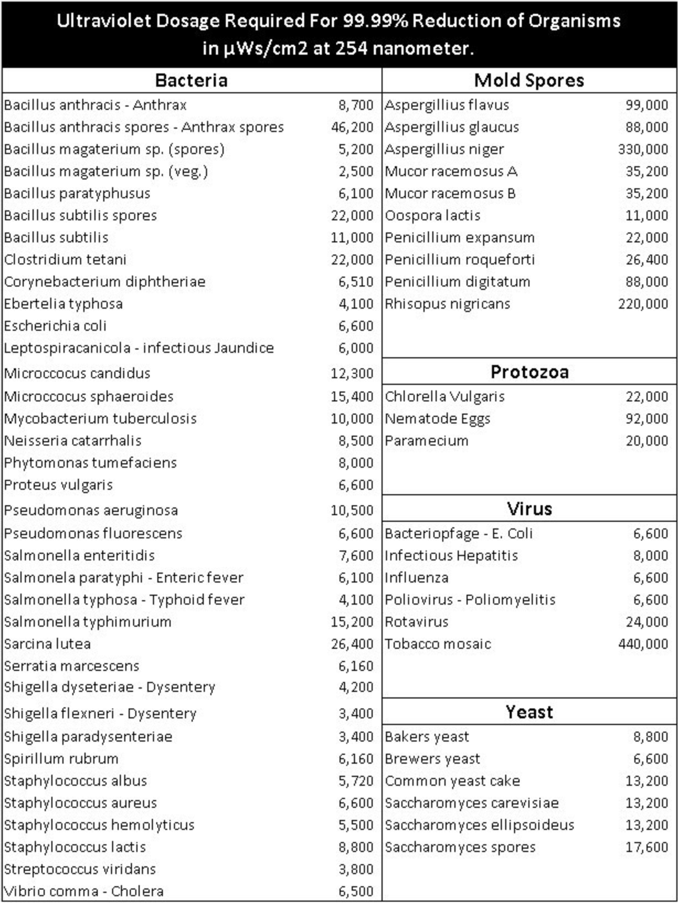
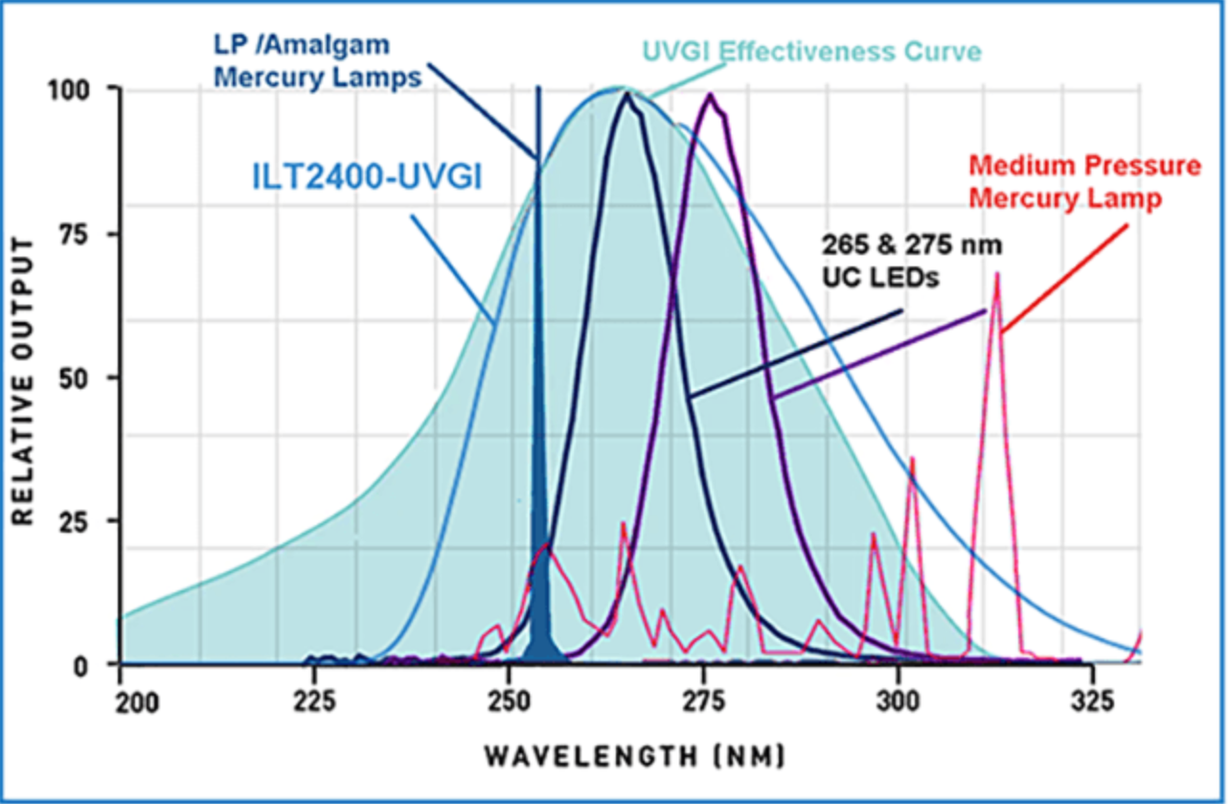
How UVC cleans the water
UVC is able to cleanse the water of coliforms and pathogens through the process of ultraviolet germicidal irradiation (UVGI)
Shown on the right in the chart are common coliforms found in water and the UV dose required to eliminate or disable them
UVGI effectiveness curve shown to the right and common technologies with their wavelengths produced
https://www.intl-lighttech.com/products/ilt2400-uvgi

Slide 8
UV Cleaning Specifications
The devices LEDs are housed in two unique optical setups to effectively eliminate pathogens deemed dangerous to consume or contact
The device was able to effectively clean at multiple power levels to allow for use in a variety of scenarios
High power LED array producing greater than 50 mWs UVC light
Low power ambient scanning LED array producing near 5 mWs of UVC
Low pressure mercury lamp producing 6.8 W UVC
These different power levels would allow for the water to be processed more quickly once the first batch of coliform testing is completed

Slide 9
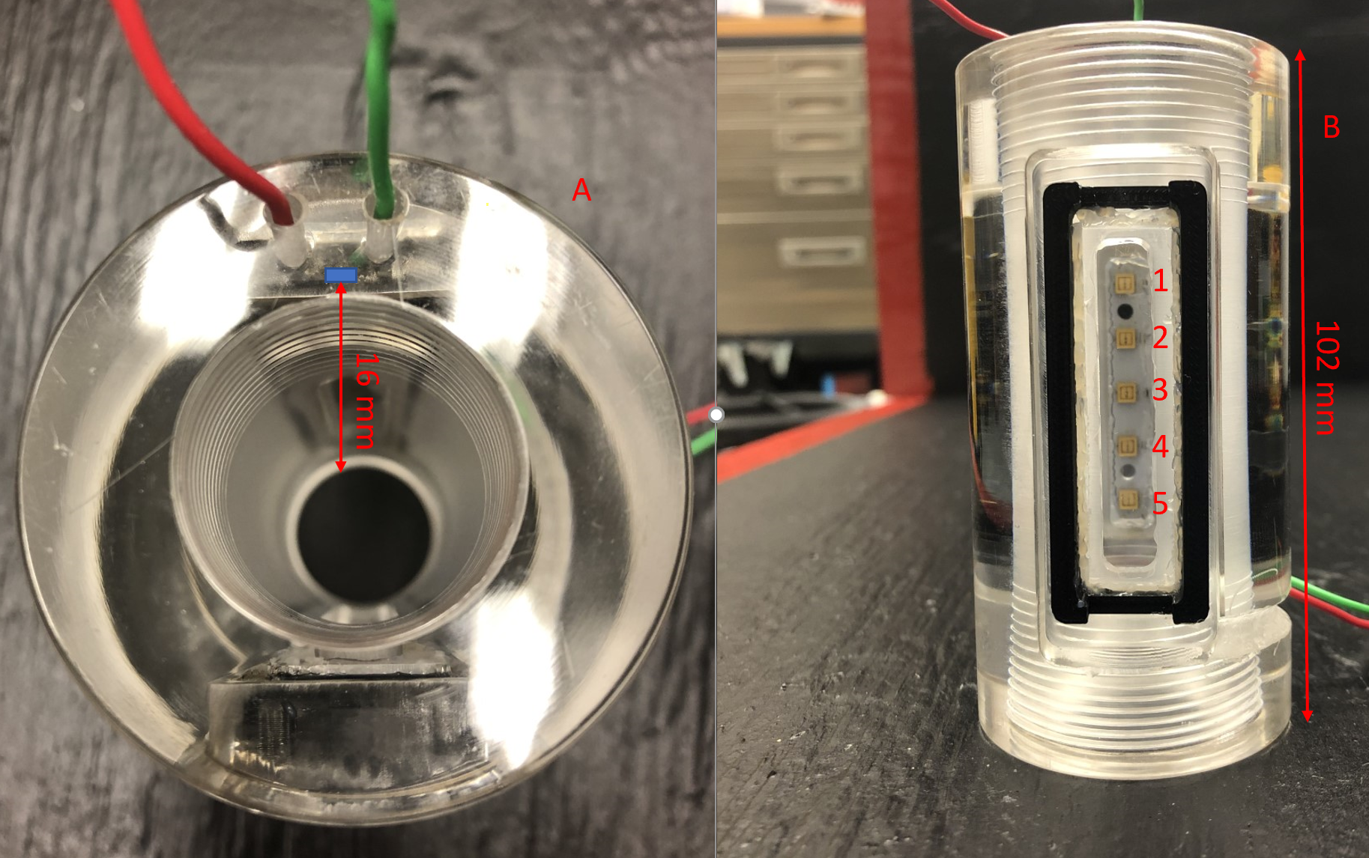
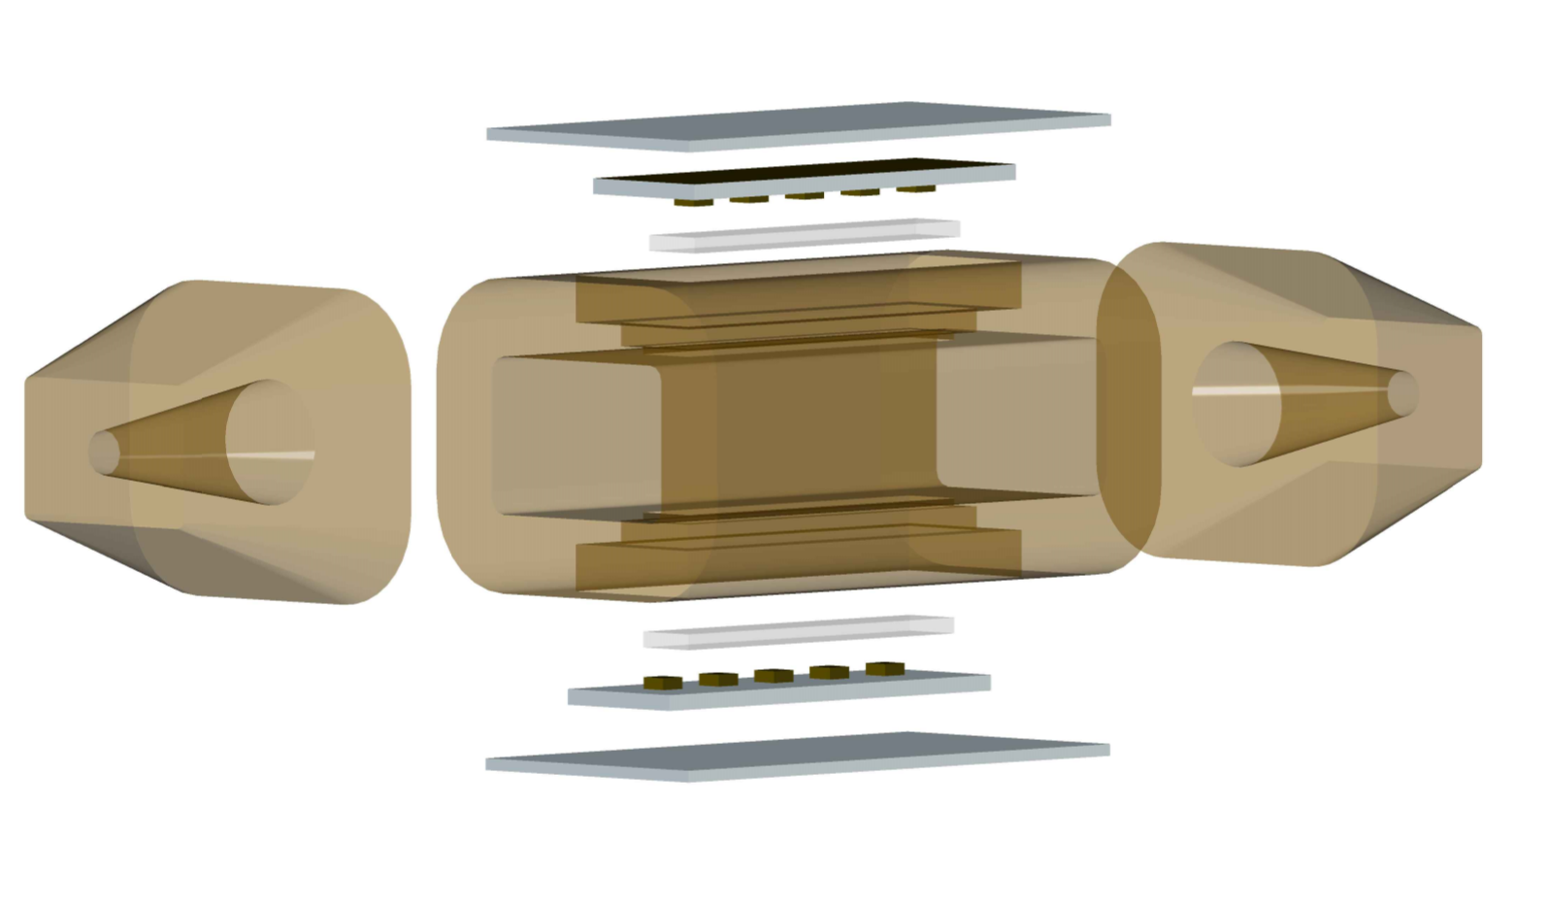
High Power LED Panel Design vs Project Implementation
Shown in the the first photo on the left is the original design and the second photo on the right is the housing with one LED panel placed.
The final high power array used in the project had a circular inner design and was mounted vertically to reduce water turbulence and increase UV penetration.

Slide 10
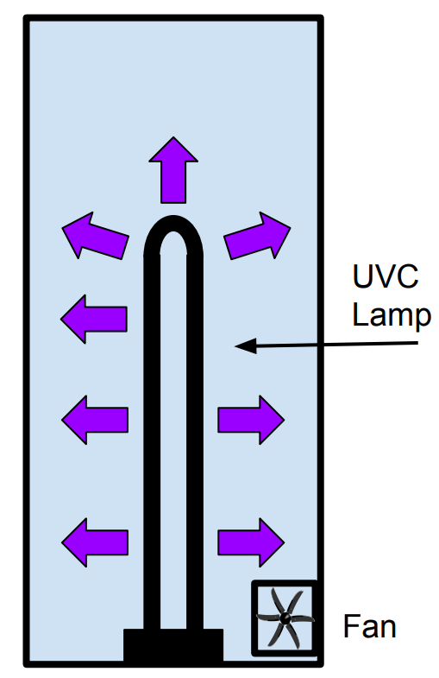
UVC Lamp
The UV lamp is used inside the processing tank when it is determined that a higher power UVC light is needed to kill the coliform than can be delivered by the LEDs alone
The UV lamp purchased for the project is shown in the photo to the right as well as how it will be employed
The lamp when run outputs 8.5 Watts within the UV range, 6.8 Watts of that in the UVC wavelength regime
10,000 hour lifetime

Slide 11
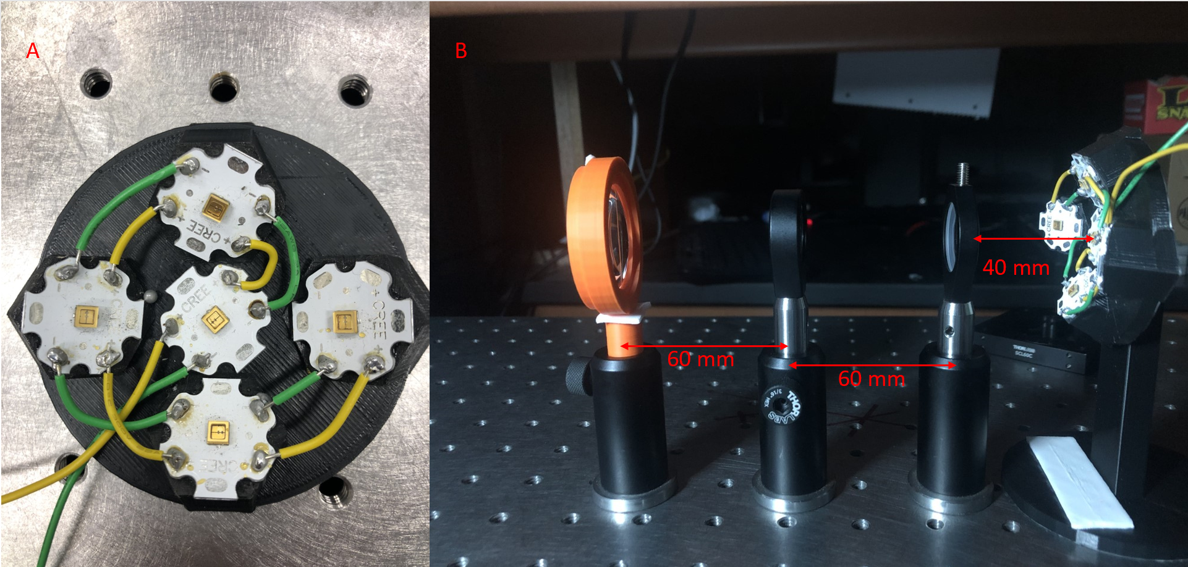
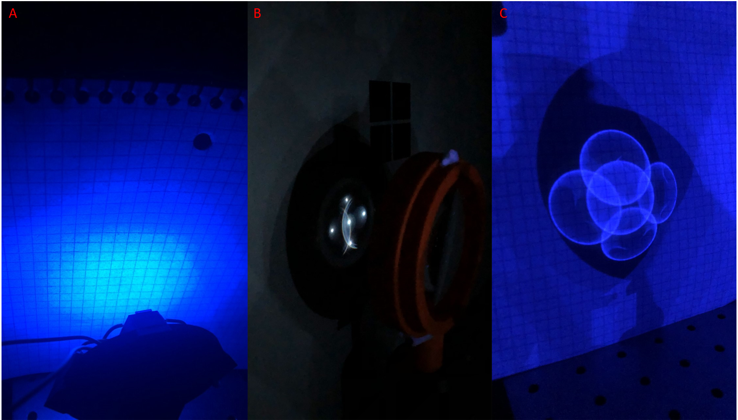
UVC LED ambient cleaning array
The UVC led array is used to eliminate additional bacteria that arrive in the processing tank through open air exposure.
Shown on the left in photo A is the LEDs mounted in a custom made 3D printed mount. Photo B shows the array lenses aligned and the distances used in the experiment.
Shown on the right is the focusing effect produced from the array at 5 cm and 25 cm from the front lens

Slide 12
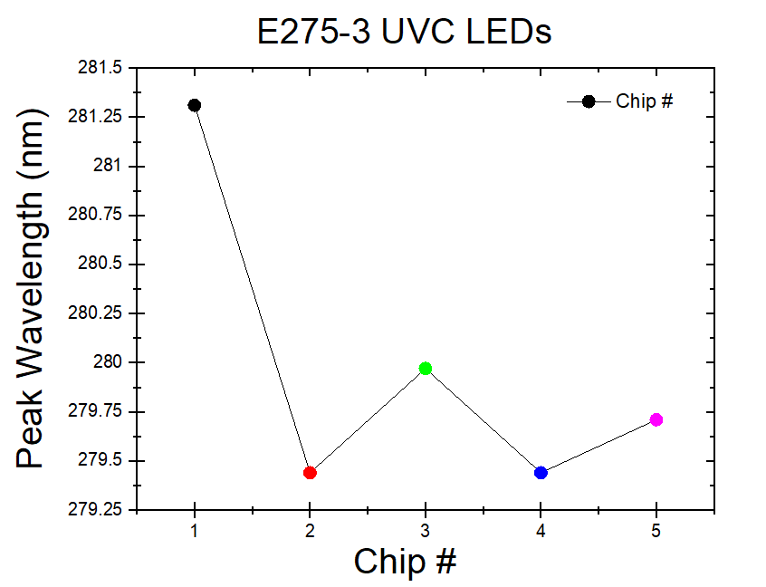
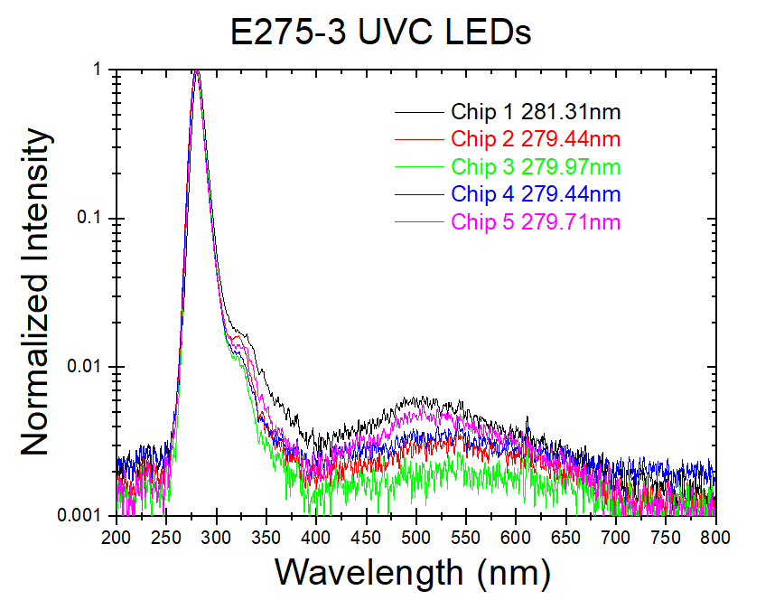
UV LED spectrum
To ensure that the device indeed produced UVC wavelengths the LEDs used for the project had to be tested
As shown in the two photos below the LEDs indeed produced wavelengths in the UVC regime and were centered around 279 nm on average

Slide 13
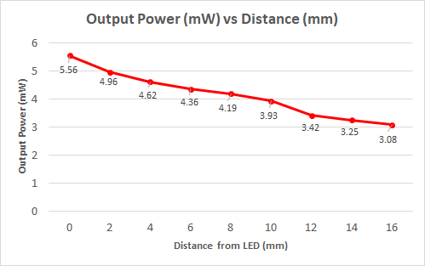
UV LED power Testing
To ensure that the UVC diodes produced enough power to effectively clean the water testing was done to determine the power drop off associated with distance from the LED.
The graph shown below shows the power output from the LEDs on average as the distance from the LED increases

Slide 14
Constraints for UVC cleaning
Cost was a primary constraint in the project
UV optics often require coating in most applications and require specific materials if they are to allow emission
Fused Silica is often expensive and takes longer to process
Quartz used for the windows was also costly forcing a design with minimal output windows to be considered
UVC requires more specific tools for measurements and verification
The UVC wavelength produced from the diodes being near 275 nm requires specified power meters for appropriate power verification
Shipping and processing for almost all materials was delayed
Not only this but the lack of stock of many materials forced the team to reevaluate the design several times as well as implement a process to allow the design to withstand additional features changes

Slide 19
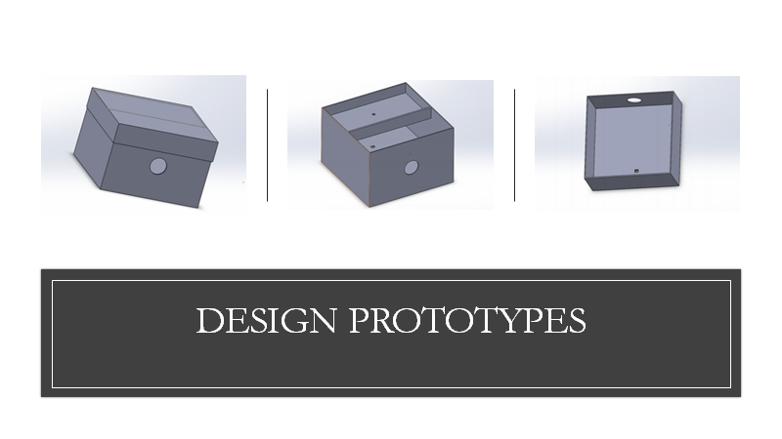

Slide 22
Software system design

Slide 23
Goals
and Requirements
Develop a Live system to capture and display environment information
Create and intuitive, reactive User Interface
Everything needed should run on a single MCU

Slide 24
Technology Choices

Slide 25
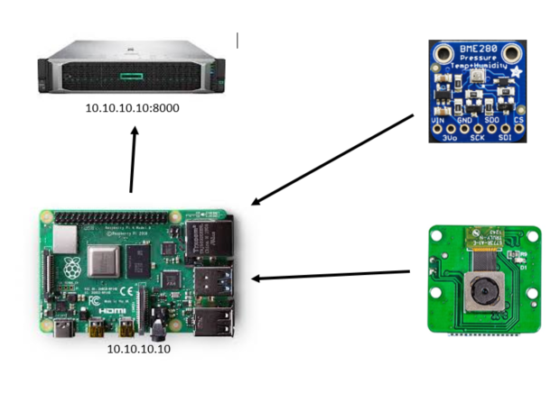
Raspberry Pi Sensor System
Arducam – Raspberry Pi Camera
BME280 – Temperature, Humidity, Pressure
Additional Sensors

Slide 26
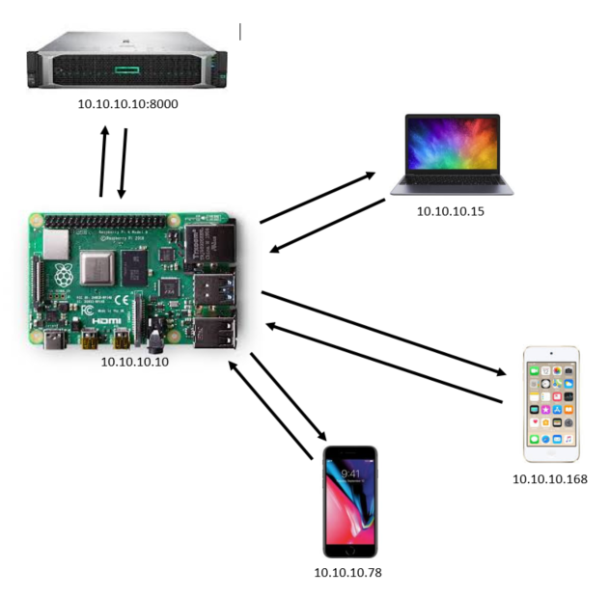
Hosting the UI
Raspberry Pi as an Access Point
DNSMasq and Hostapd
Node.js and Express.js

Slide 27
Milestones
Task | Start | Estimated End | Status
Specifications and Requirements | 5/11/20 | 7/30/20 | Finished
Purchase Needed Materials | 7/1/20 | 7/14/20 | Finished
Setup Raspberry Pi Environment | 7/15/20 | 7/15/20 | Finished
Read and Process Sensor Measurements | 7/16/20 | 9/30/20 | In Progress
Develop GUI | 7/30/20 | 10/1/20 | In Progress
GUI and Sensor Integration | 9/30/20 | 10/1/20 | In Progress
Final Testing | 8/31/20 | TBD | Not Started

Slide 28
Power System Design & PCBs

Slide 29
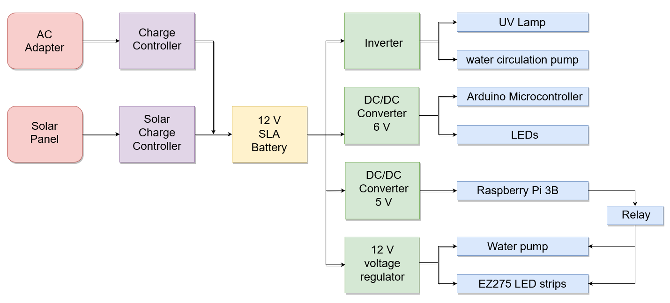
Power System Overview
PUVC will be powered by both solar panels and wall outlet
Design Specification: PUVC must be solar powered for portability

Slide 30
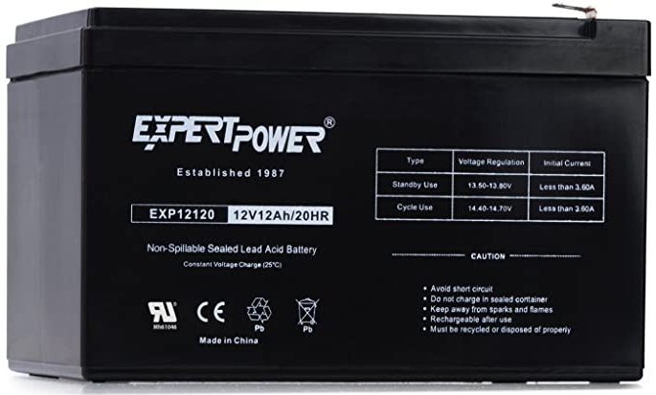
Battery
12 V lead-acid battery
12 Ah capacity
Allows for over 4 operating hours per charge
Dimensions: 6 x 3.8 x 3.7 inches
Affordable

Slide 31
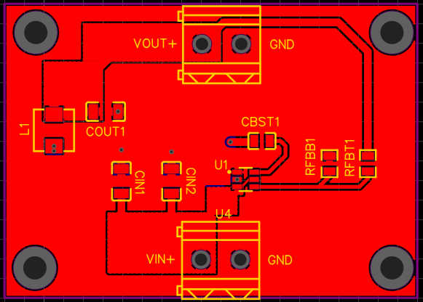
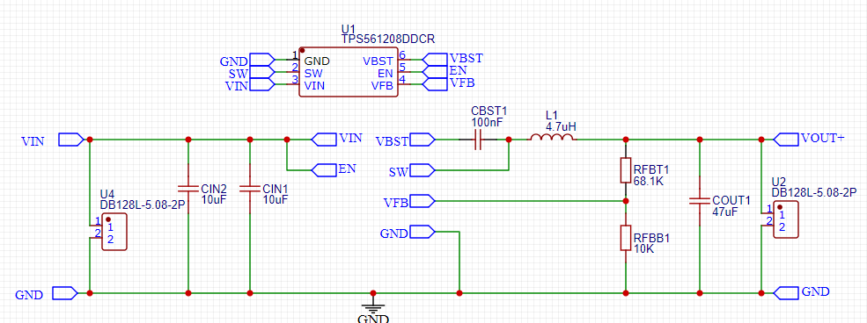
6 V converter
Designed with TI Webench Power Designer
Parts were chosen primarily based on keeping cost down
PCB schematics and board layout done in EasyEDA
Uses TPS561208DDCR

Slide 32
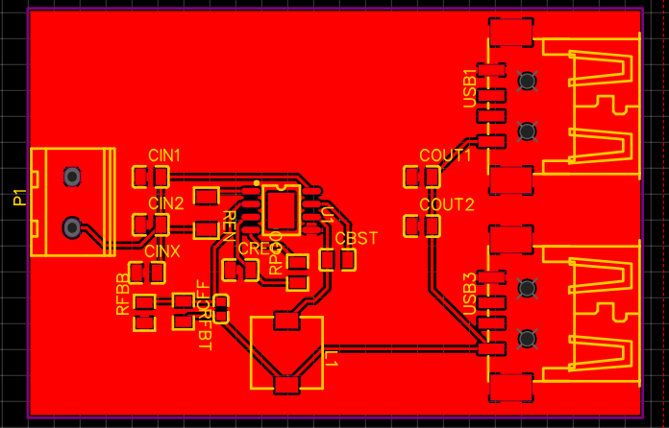
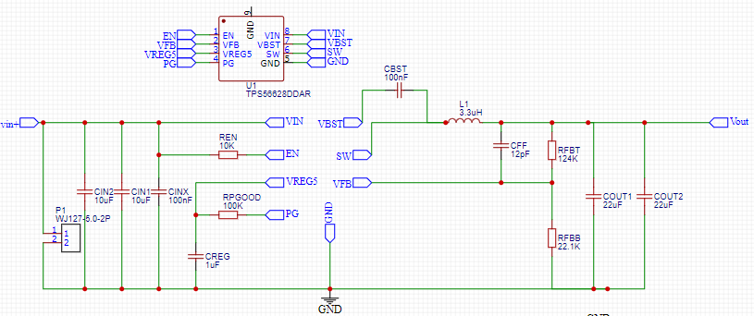
5 V converter
Outputs 5.1 V with a max current 2.5 A
Uses TPS56628DDAR switching converter
USB port at output terminals

Slide 33
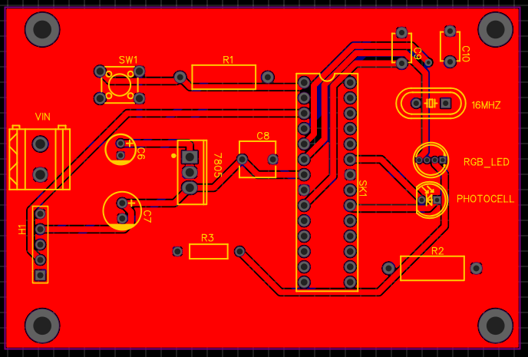
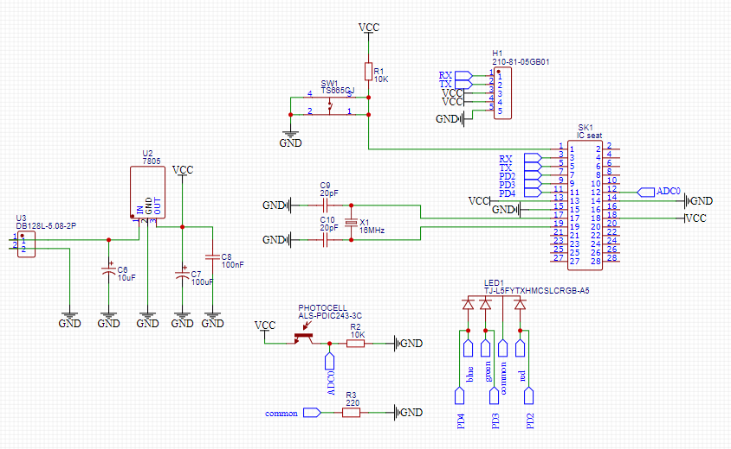
Microcontroller PCB
ATmega328
28-pin socket
Color sensor components
UART jumper pins

Slide 34
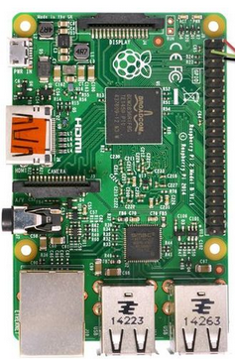
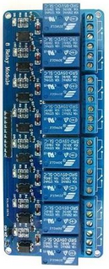
Switching devices on and off
Water pumps and LEDs will be switched on/off by relay connected Raspberry PI GPIO pins
Raspberry Pi 3B
Relay board

Slide 35
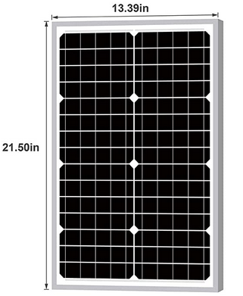
Solar panel
30 W Monocrystalline solar panel
The goal is to have the PUVC run a cleaning cycle completely off of solar panel power in the right conditions
Panel size: 21.54 x 13.39 x 1.10 inch

Slide 36
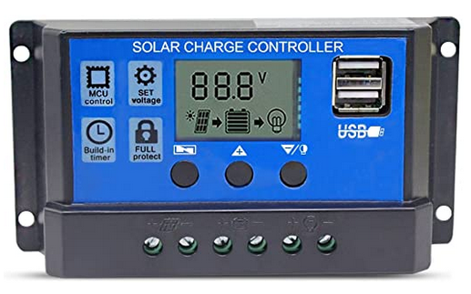
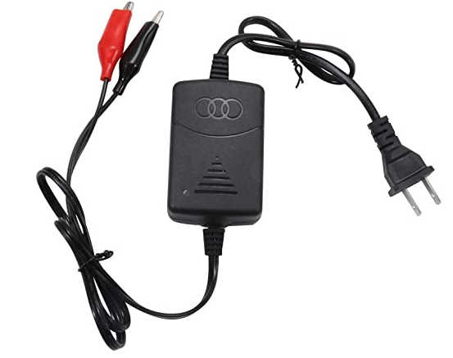
Chargers
3-stage PWM solar charger
Backup charger that connects to wall outlet for when solar power is unavailable
Both chargers have short circuit protection
The battery is to be charged at 1 A which is about 10% of the battery capacity

Slide 37
Administrative Content

Slide 38
Budget & Financing
The PUVC is financed entirely by group members
Item | Vendor | Price Per Unit | Amount | Total Price
UVC LEDs | ILT | $14 | 14 | $196.00
UV Lenses | Edmund | $160 | 3 | $480.00
UVC Lamp | SLRU | $116 | 1 | $116.00
Raspberry Pi 3b | Adafruit | $35.00 | 1 | $35.00
Water Tank | Gatorade | $25 | 1 | $25.00
Water Pumps | Amazon | $11.00 | 3 | $33.00
Solar Panel | Amazon | $41.00 | 1 | $41.00
Solar Charge Controller | Amazon | $15.00 | 1 | $15.00
12 V SLA Battery | Amazon | $31.00 | 1 | $31.00
PCBs | JLCPCB | $54.00 | 1 | $55.00
PCB components | LCSC | $35.00 | 1 | $35.00
AC Battery Charger | Jun-Electron | $13.00 | 1 | $10.00
Inverter | Amazon | $40.00 | 1 | $40.00
Quartz Windows | EKSMA | $40 | 3 | $120.00
Pre-Processing Filter | Amazon | $35 | 1 | $35.00
Arduino UNO | Arduino | $23.00 | 1 | $23.00
RGB LED | King Bright | $11.88 | 1 | $11.88
CDS Photocell | Adafruit | $9.94 | 1 | $9.94
Coliform Test Kit | Clean Water Store | $16.90 | 1 | $16.90
Arducam 5 | Jun-Electron | $10.00 | 1 | $10.00
Water Level Sensor | Adafruit | $14.00 | 1 | $14.00
BME280 | KOOBOOK | $5.00 | 1 | $5.00
DS18B20 | IZOKEE | $5.00 | 1 | $5.00
3D printer material | Makerbot | $69.00 | 1 | $69.00
Total |  |  |  | $1,431.72

Slide 39
Questions?

